Slide 1
Eco Fest
Create a multi page website
Go to student share/ICT/Year 9/Eco Fest
Copy the folder into your own documents.
Open the Powerpoint and the assignment.
Read the scenario on the first page of the assignment.

Slide 2
What is Eco Fest?
Eco Fest is a family-friendly one day music festival.
It aims to showcase local talent whilst affecting the climate as minimally as possible.

Slide 3
What is target audience?
Target audience can be grouped by the following categories:
Age
Gender
Location
Ethnicity
Target audience is a particular group that an event/advertisement/product is aimed towards.

Slide 4
Question for you: Who is the target audience for Eco Fest? Explain who they are and how you could meet their needs.
Eco Fest is targeted towards families. This is stated in the assignment brief. Families contain people of all ages and genders, meaning you have to have something to appeal to everyone. Family get-togethers are also used as bonding time, so we need to keep that in mind too.
In order to please a family, you have to ensure that everyone has something for them. Young children, teenagers, and parents of all genders.

Slide 5
What are “client requirements”?
Interpret the client requirements in the scenario and give some ideas about how you will achieve what they want. Write a paragraph on the next slide to explain what you have been asked to do and how you might do it.
Eg The client wants an appropriate navigation system so I will create buttons that will appear on each page in the same place so it will be easy for users of the website to find them.

Slide 6
Explanation of client requirements
In order to achieve the consistent look, I shall use one stylesheet to power the entire website and copy and paste the markup for each page, changing the content as necessary.
To achieve an accessible navigation system, I shall keep the buttons for navigation in the same place on every page – which will also fit in with the consistent look specified in the design brief.

Slide 7
Starter
What is a Gantt chart? Google it and find some examples.
By the end of today’s lesson you need to have completed:
Target audience
Client requirements
Workplan or Gantt chart

Slide 8
Workplan
Look at the next two slides for different ways creating a plan of activities, deadlines and resources.
You could use a spreadsheet or word processor.
Now create a workplan to show all the activities you think you will need to do to complete this project. Slides 7-13 of this powerpoint detail the tasks you have to do.Your deadline is Friday 28 June.
Also known as a project plan
A list of tasks and activities that you need to do to complete the project.
Should also include:
Timescales or deadlines
Milestones
Resources needed
contingencies

Slide 9
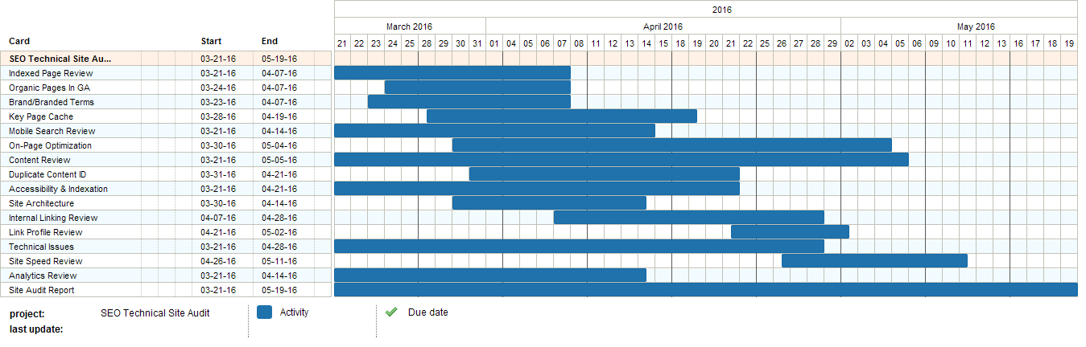
Gantt Chart

Slide 10

Task | Activity | Resources | Contingency | Deadline
Produce report re target audience | Analyse the brief and write a paragraph | Brief; Word | Allow an extra hour in case of absence | 20.5.19
Produce a report re client requirements | Analyse the brief; think of suggestions for meeting the requirements; write the report | Brief; Word | Allow an extra hour in case of absence | 22.5.19
End of analysis
Produce planning documents | Gantt chart OR task list | Excel/Word
Planning documents | Site map | Powerpoint
Planning documents | Visualisation
etc

Slide 11
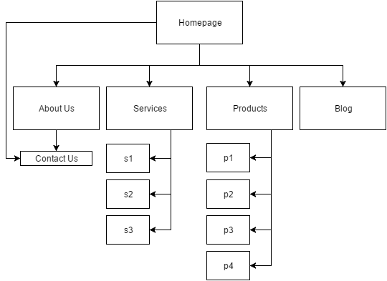
Producing ideas – site map
Page name
Hyperlinks between pages
Create a site map for your website to show what pages you will have and how they are linked together.
Is the Blog page linked directly to the S1 page?
Is the Homepage linked directly to the Contact Us page?

Slide 12
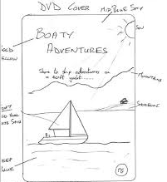
Visualisation
A visualisation is simply a layout sketch to show what your web page will look like.
Show where images and text will go
Annotate with colours/fonts
Bold yellow
mountains
Red hull white sails
shoreline
Create a visualisation diagram for the home page of your website.
Deep blue

Slide 13
Legal restrictions
Copyright and intellectual property: images, music, films
You must ask for permission to use
Creative Commons: you can use without asking for further permission: the conditions of use are attached to the work
Certification and classification: film certification eg PG, or on music “Parental Guidance”
Data protection: personal data about people must be kept securely. You will not be keeping any personal data for this project.
Privacy and defamation: if you infringe someone’s privacy online eg you give out their personal information or share inappropriate images, you can be sued for this. This legislation is not relevant for this work.
Write a short report explaining the importance of checking copyright on assets you intend to use. Explain what is meant by Creative Commons.

Slide 14
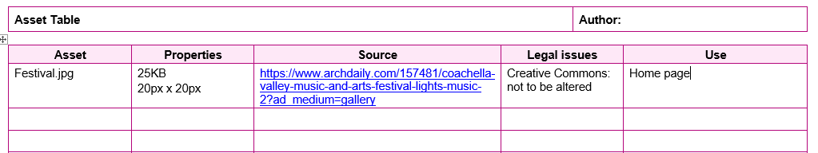
Assets
You will need to collect the images, sounds or video you intend to use on our web pages and store the files in a folder called “Assets”.
You should create an assets table as you collect them.
Use the template in the Eco Fest folder.
The name of the file, including the file extension.
This is found in the image properties.
The URL of the website where you found the image NOT GOOGLE!
Copyright or Creative Commons?
What page will you use it on?

Slide 15
Now make your home page!
Don’t forget to use your plan, the visualisation diagram and the site map you have made.
Use Notepad to create the HTML page.
Use W3schools.com as a resource to help you find out how to do things.
You should use a stylesheet for all your styling (CSS document).
Use the home page as the basis for the rest of your pages; you will copy it and change the content.

Slide 16
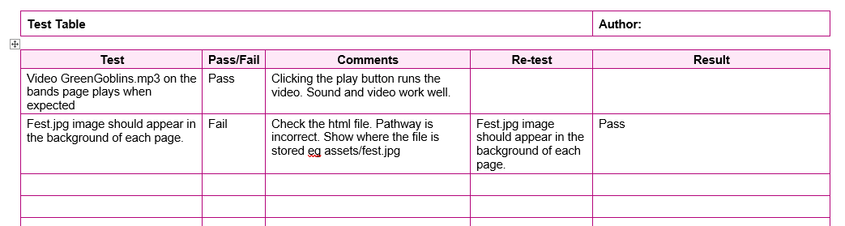
Test your web pages
You should carefully test that all your links work, images appear in the right place, fonts are the right size and colour, in fact, test everything to make sure the page is exactly what you wanted.
Use the test table template in the Eco Fest file.
Obvs!
Obvs!
What happens?
What am I testing?
What re-test do I need to do?

Slide 17
Review
describe how well the multipage website meets the client’s requirements
explain how and why the multipage website could be improved
describe reasons for further development, giving reasons for your choices

